Slide 1

DEPARTMENT OF COMPUTER SCIENCE AND ENGINEERING STAY ALERT FOREVER(SAFE)
Under the Guidance of
DR.RAJ KUMAR PATRA
(Professor)
BY
B.KAWSHIK (197R1A05K0)
G.SAI MAHESH (197R1A05K9)
M.SAI KUMAR (197R1A05M8)

Slide 2
ABSTRACT
In today’s world, safety is the major concern for everyone while driving. There is one death for every 4 minutes due to road accidents in India.
The fatalities by road accidents is more than that of the fatalities caused by other aspects in India.
Our government is trying to prevent the road accidents in many ways by creating awareness on traffic rules, safety measures etc.
As a responsible citizen, we would like to contribute our best by creating an APP to prevent the accidents.
This app will monitor the coordinates of the user based on the GPS and when the user is close (~1 KM) to the accident-prone area the app will raise a Notification to alert the user.
This help the users to be more cautious about the upcoming black spots and the speed limit of vehicle get reduced which prevents the possible accident by alerting the user and save lives of our beloved ones.

Slide 3
EXISTING SYSTEM
Government identifies the black spots and spread the awareness to the public with the help of hoardings, traffic signals and media etc.
Traffic rules are imposed by the government but still lot of citizens don’t obey them due to various factors.
There are lot of challenges with the current system as it purely depends on the individual to make sure to follow the rules and at the same time it will be very difficult even for the government to identify each and every black spot throughout the country.

Slide 4
DISADVANTAGES
Not following traffic rules
Distraction to the user by different reasons
Unaware of the accident spots
Unknown of the existing speed of the vehicle

Slide 5
PROPOSED SYSTEM
Today almost everyone is using smart phone, internet and every person is aware of using the apps in mobile. This APP will identify the position of users using GPS and fetches the black spot coordinates from the system. Accident prone areas or Black spots can be identified and obtained by the different sources.
It compares the distance between the current position of the user and the black spots, if the distance between both is approximately close to 1 km will raise a voice message in mobile.
The system will be updated on periodic basis with authentic data about black spots. Rest API is used to pull the data from database and compare it against the coordinates of the user using GPS.
It measures the speed of the vehicle and when the vehicle reaches the limit, then it will raise the voice message.

Slide 6
ADVANTAGES
Helps proactively to save the life of an individual.
Helps to control the damage if happens in case of an accident.
User can access the information easily using mobile.
Aware of the accident spots well in hand.
Speed of the vehicle can be maintained within limits
More accidents can be controlled

Slide 7
HARDWARE REQUIRMENTS
Smart Phone android with latest version.
RAM: 6GB and above
Space on Hard Disk: minimum 5GB
Processor: AMD Ryzen 3 2500U and above

Slide 8
SOFTWARE REQUIRMENTS
Android Studio – 2021.2.1.15
Java, xml
Rest API
MySQL – Database

Slide 9
NOVELTY
This app is used for identification of accident prone zones and also the speed of the vehicle.
Low-cost implementation, which is appropriate when the market is scaling up.
User can, not only maintain speed limits but also avoid accidents.

Slide 10

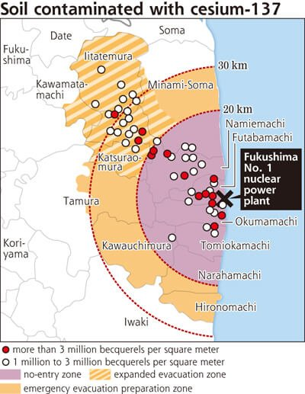


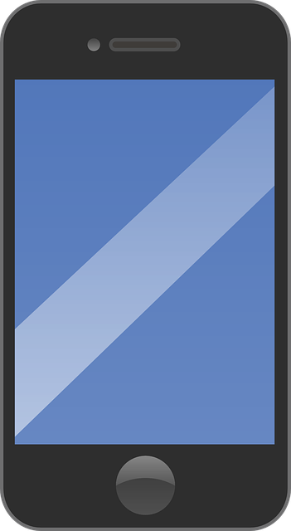

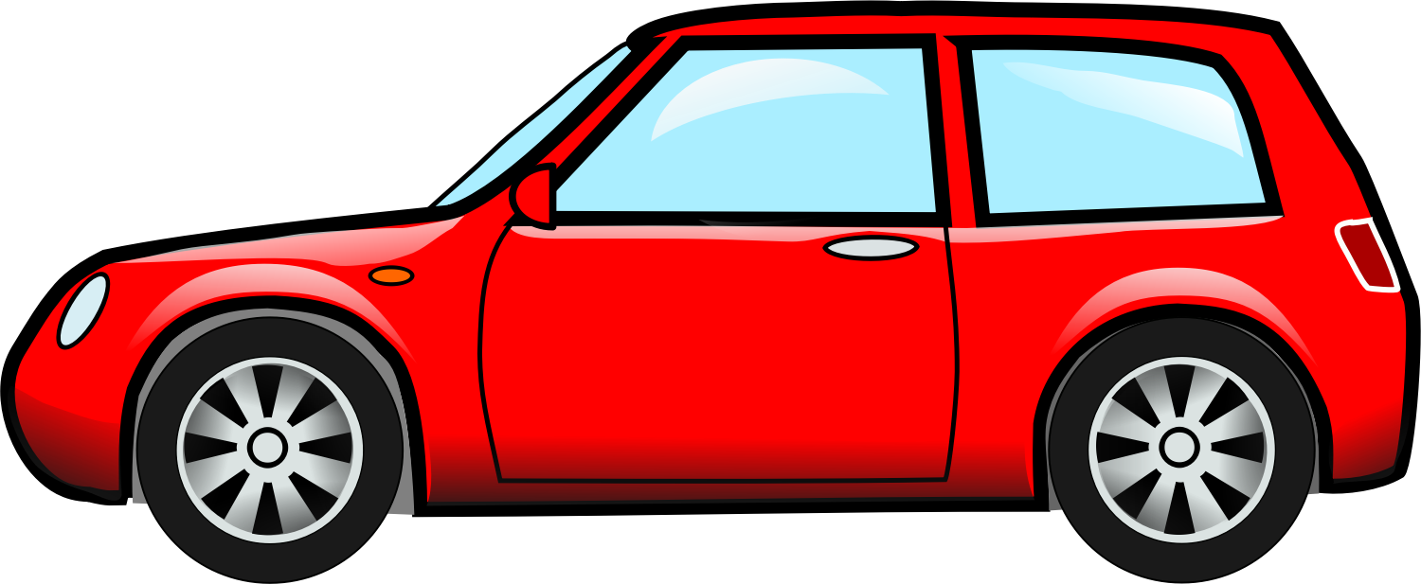
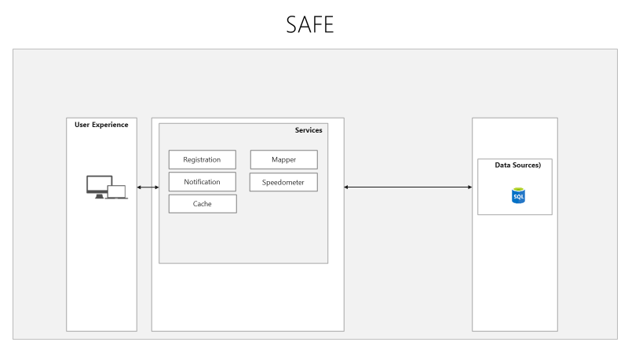
ARCHIITECTURE
Route is Generated
Connect To Database
if spot is less than 1 km
Connect to Internet
Map is shown to user
raise an alarm/voice message
Enter Location Details
Check No of Spot
User is driving the car

Slide 12
MODULE
TYPES OF LOGINS:-Three Type of Login. User , Admin and System.
USER REGISTRATION:-User have to register first for which he need to provide a valid user email and mobile number for further communications.
LOGIN:-User have to Login, to access credentials .Once he got credentials user can use it.
ADMIN:-Admin can login with his credentials .Once he login he can activate the user.
DATA PREPROCESS:-The admin provided data ,has been stored in the Database.
SYSTEM:-Through that Database ,System gets Navigates through GPS and Detect the location and detected data Display on the Admin side.
GENERATE ALARM/VOICE MESSAGE:- Admin verify and System generate the Alarm/Voice message to alert the user to avoid accidents.
MODEL EXECUTION:-Using the Android Development ,we predict the Accident prone Zones.

Slide 13
UML Diagrams
Use case Diagram:-
Registration
Log in
admin
Enter Location Details
Navigate Through Co-ordinates (GPS)
Detect Accident Location
Raise a Voice message/Alarm
User
Message on reaching to Destination
system

Slide 14
Class Diagram:-
USERS
U_First Name : String
U_Last Name : String
U_Mob_No : int
U_Password : String
APZS
APZS_No : int
APZS_Name : String
APZS_Initialization_Data:data
GIS_Detail : String Data_Detail : String
GIS
G_Latitude:double
G_Longitude:double
Map_Area:String
1
1
1
1
Get query()
Exit() +-----()
Get query()
Exit() +-----()
1
*
STREET
S_Name : String
S_No : int S_Address : String
Set_Details() Get_Details()
+-----()

Slide 15
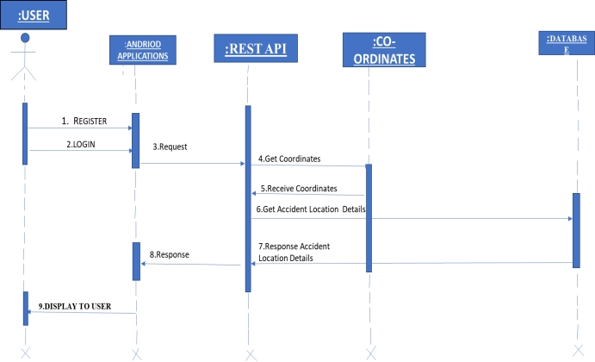
Sequence Diagram:-
:USER

Slide 16
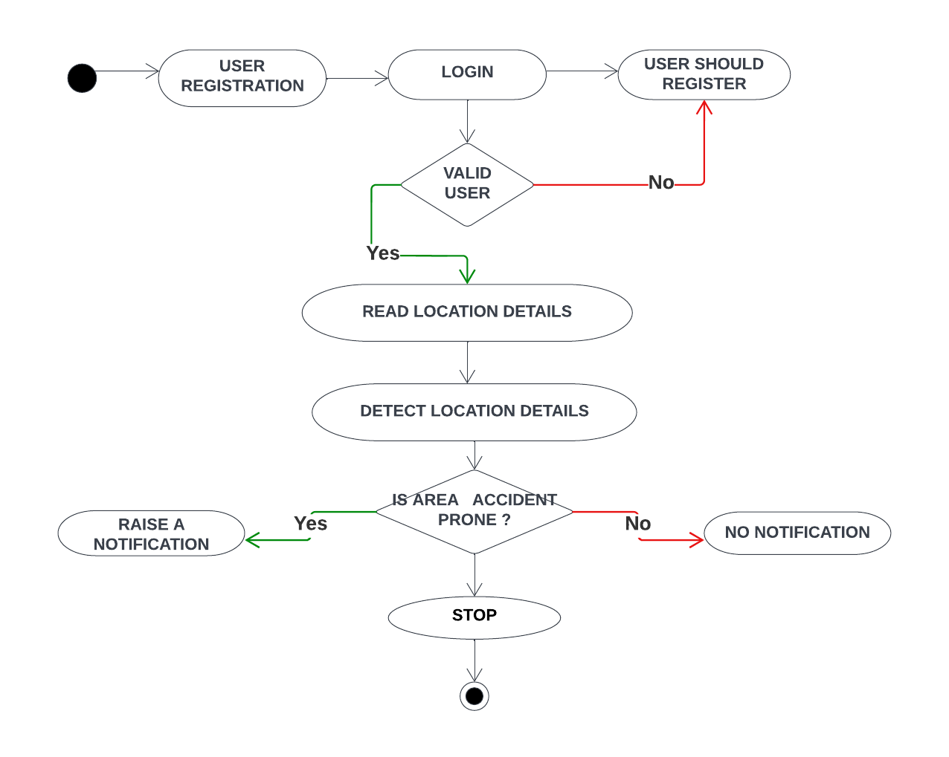
Activity Diagram:-

Slide 17
Source Code:-
Main Activity
package edu.gcu.gpstrackingdemo;
import androidx.annotation.NonNull;
import androidx.appcompat.app.AppCompatActivity;
import androidx.core.app.ActivityCompat;
import android.Manifest;
import android.annotation.SuppressLint;
import android.content.pm.PackageManager;
import android.location.Address;
import android.location.Geocoder;
import android.location.Location;
import android.os.Build;
import android.os.Bundle;
import android.view.View;
import android.widget.Button;
import android.widget.Switch;
import android.widget.TextView;
import android.widget.Toast;
import com.google.android.gms.location.FusedLocationProviderClient;
import com.google.android.gms.location.LocationCallback;
import com.google.android.gms.location.LocationRequest;
import com.google.android.gms.location.LocationResult;
import com.google.android.gms.location.LocationServices;

Slide 18
TextView tv_lat, tv_lon, tv_altitude, tv_accuracy, tv_speed, tv_sensor, tv_updates, tv_address, tv_wayPointCounts;
Button btn_newWaypoint, btn_showWayPointList;
Switch sw_locationupdates, sw_gps;
FusedLocationProviderClient fusedLocationProviderClient;
boolean updateOn = false;
LocationCallback locationCallback;
LocationRequest locationRequest;
@Override
protected void onCreate(Bundle savedInstanceState) {
super.onCreate(savedInstanceState);
setContentView(R.layout.activity_main);
Location currentLocation;
tv_lat = findViewById(R.id.tv_lat);
tv_lon = findViewById(R.id.tv_lon);
tv_altitude = findViewById(R.id.tv_altitude);
tv_accuracy = findViewById(R.id.tv_accuracy);
tv_speed = findViewById(R.id.tv_speed);

Slide 19
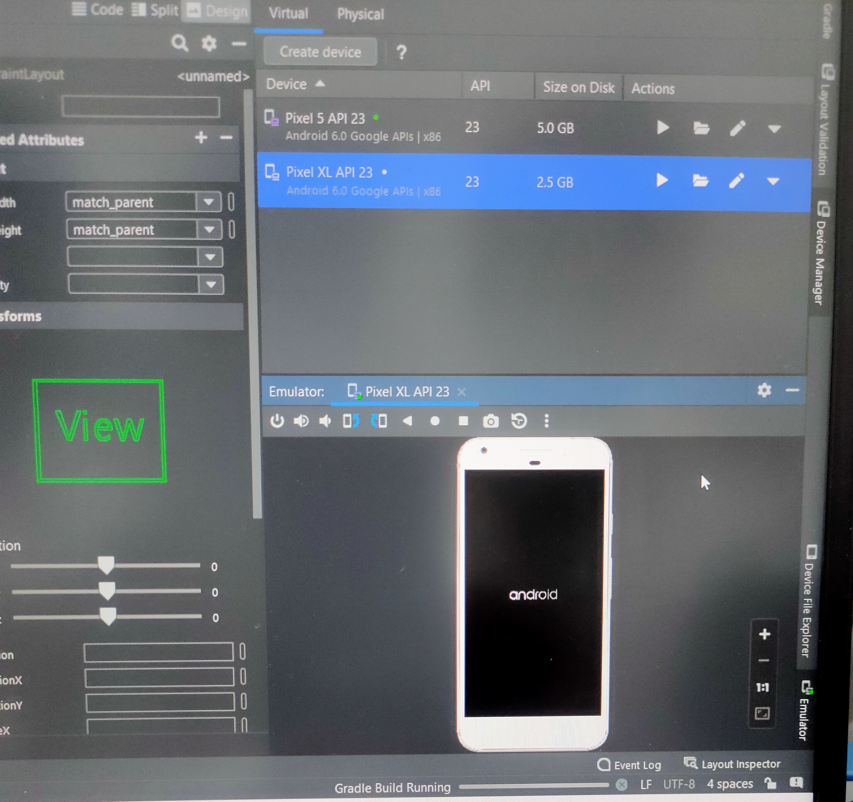
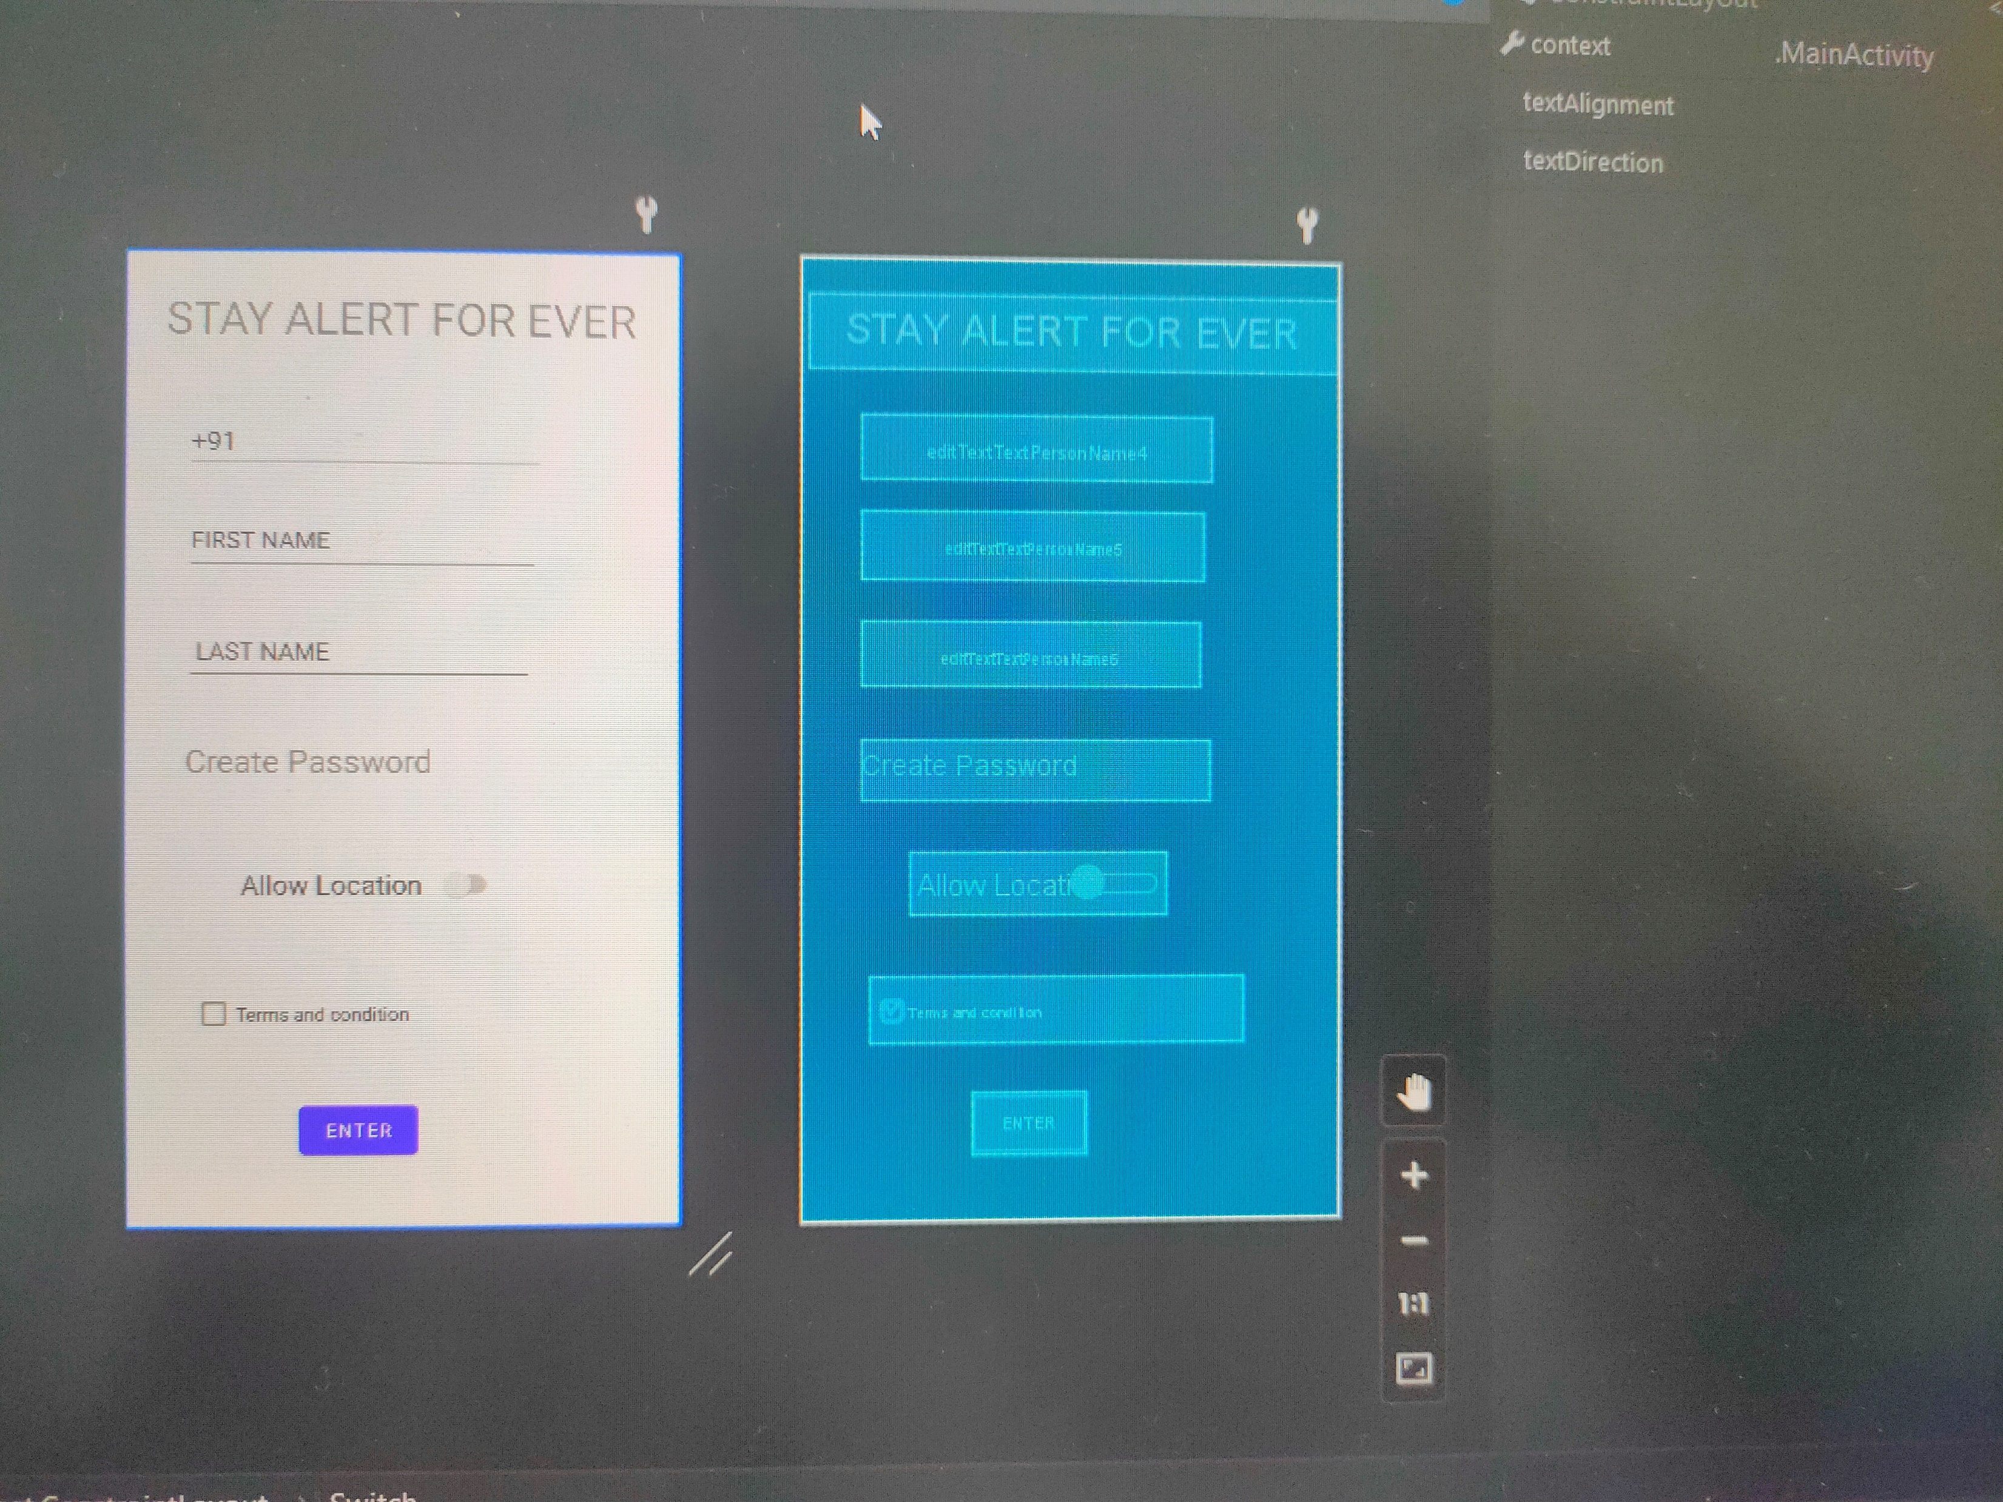
SCREENSHOTS(RESULT)

Slide 20
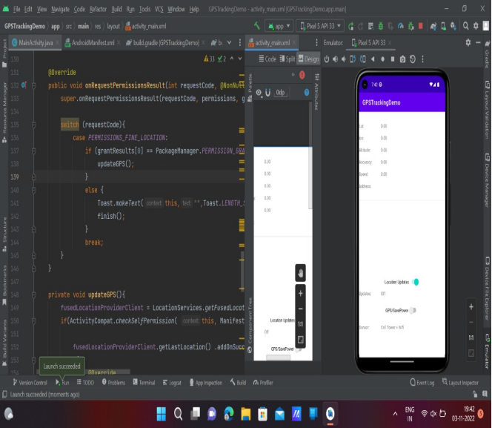
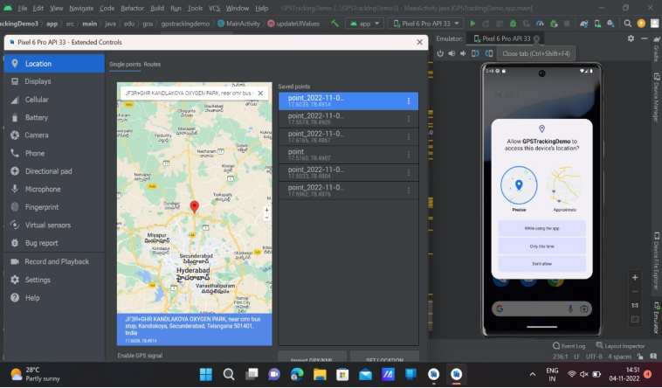

Slide 21
CONCLUSION
This APP is useful to make everyone comfortable to stay safe by proactively raising the voice message.
It also reminds the exceeding speed of the vehicle beyond safe speed on that particular road to avoid accidents
This helps to overcome the current challenges to maintain safety measures in the society.
This APP definitely plays a key role in decreasing the percentage of road accidents and death rates.

Slide 22
FUTURE ENHANCEMENTS
Currently, we have incorporated choosen and selected areas, places all over Telangana/India can be incorporated with the help of Govt. or tie ups with NGOs or Organizations
Tie up with Google Maps for wide range of usage and provide safety even without downloading the APP.

Slide 23
GITHUB LINK
https://github.com/kawshikbhyroju/SAFE

Slide 24
THANK YOU

